Slide 1

Agriculture and Aquaculture

Slide 2
Batch members-192
190030242 Chaganti Jeevitha(cluster-2)
190031793 Yarkareddy Bhavana Reddy(cluster-2)
190030860 Gnana Prasanna Korrapati(cluster -3)

Slide 3
Final requirements
Data science
In our website we will predict the weather forecast and climatic changes
Mathematical programming
Here we use linear programming

Slide 4
Objective of the project
To Provide Farmers with skills and technology required for sustainable development of agriculture, including crop production , fertilizers Details, Equipment Details , Weather Details, Soil Details , Crop Production , Irrigation Details and other allied disciplines by integrating education, research and extension.

Slide 5
Description of the wireframe tools used
We used Draw.io tool to design our wireframe
They have a large selection of shapes and hundreds of visual elements to make your diagram or chart one-of-a-kind. The drag-and-drop feature makes it simple to create a great looking diagram or chart.

Slide 6
End Users (Module wise description)
Farmer
When user logins/Register through our website, their entry will be saved in our database.
Manager
The Database manager will have a view on the user who accessed our website

Slide 7
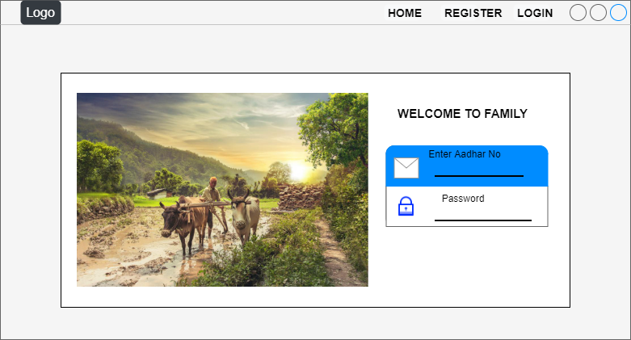
Login page

Slide 8
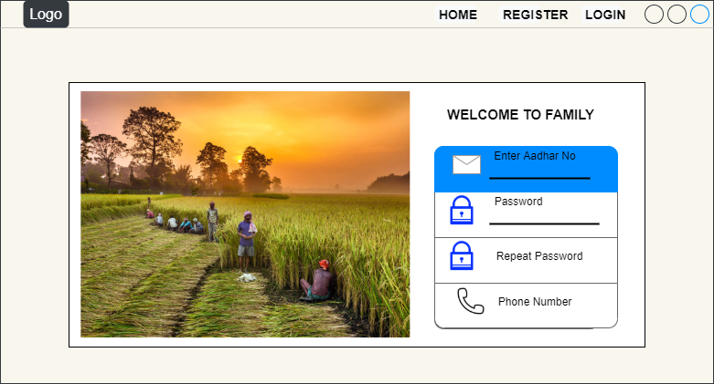
Register page

Slide 9
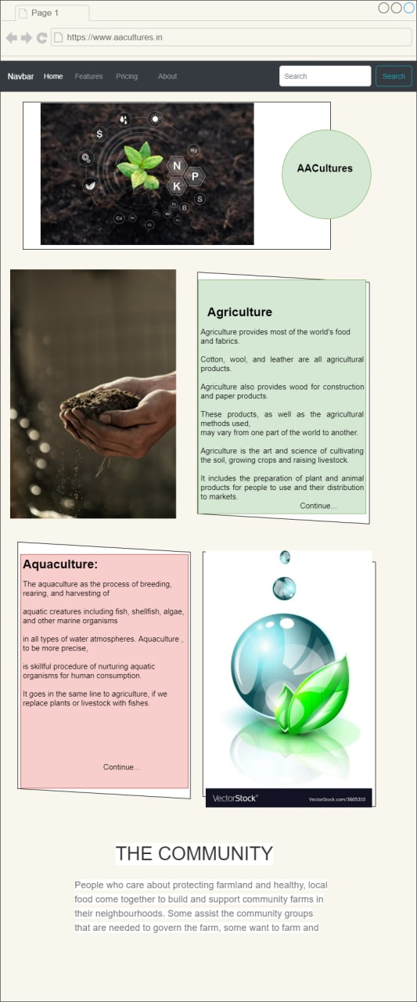
Wireframes

Slide 10
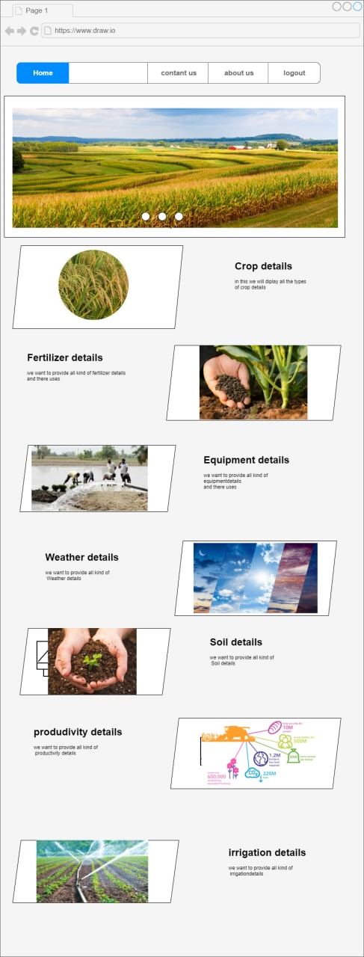

Slide 11
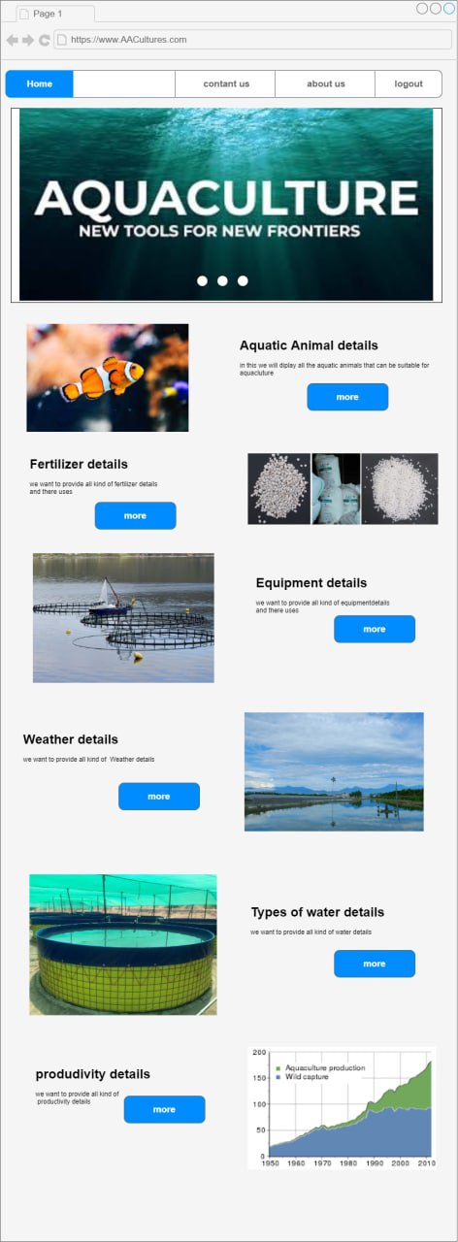

Slide 12
No of modules in web pages
They are 3 modules
Home page
Agriculture
Aquaculture

Slide 13


